Slide 1

A behavioral insight platform for coaches and coachees
Nu
d
ge
The
Machine
By Stefano Picozzi
March 2014
© StefanoPicozzi@gmail.com 2014

Slide 2
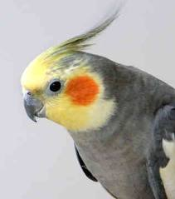
The Nudge Machine
A Coach in Your Pocket
To help people who wish to help themselves, wherever they are, whenever they need it
By building a behavioral insight platform to support coaches and coachees through small and large scale behavioral change programs
So that coachees and coaches can collaborate in a voluntary feedback loop that includes goal setting, measurement and tailored counsel
© StefanoPicozzi@gmail.com 2014
Notes:
To
Assist in individual in supporting them through a behavior change goal
Support that can reach outside the classroom setting to remote or regional locations
A coach in your pocket
By
Platform that enables instrumentation and measurement framework
That can surface content that engages both coach and coachee to participate
Scale means discovering highly targeted insight, separating the signal from the noise
Scale means automation so that coaches can triage and manage who needs targeted support even in large populations
Delivered via Internet to any devices including mobile phone, tablets and desktop
So
Enables collaboration between the behavior change participants
Coachees and coaches are vested in the process as they can configure and control how they engage
All system events controlled by rules that can be opt-in/out
Feedback loop established based on cycle of observation, measurement, reinforcement and reward

Slide 3
Benefits
A Coach in Your Pocket
Set goals, monitor, learn, adjust
Reach out to remote participants
Separate the behavioral signal from the noise
Establish feedback loop
Knowledge based builds over time
© StefanoPicozzi@gmail.com 2014
Notes:
To
Assist in individual in supporting them through a behavior change goal
Support that can reach outside the classroom setting to remote or regional locations
A coach in your pocket
By
Platform that enables instrumentation and measurement framework
That can surface content that engages both coach and coachee to participate
Scale means discovering highly targeted insight, separating the signal from the noise
Scale means automation so that coaches can triage and manage who needs targeted support even in large populations
Delivered via Internet to any devices including mobile phone, tablets and desktop
So
Enables collaboration between the behavior change participants
Coachees and coaches are vested in the process as they can configure and control how they engage
All system events controlled by rules that can be opt-in/out
Feedback loop established based on cycle of observation, measurement, reinforcement and reward

Slide 4
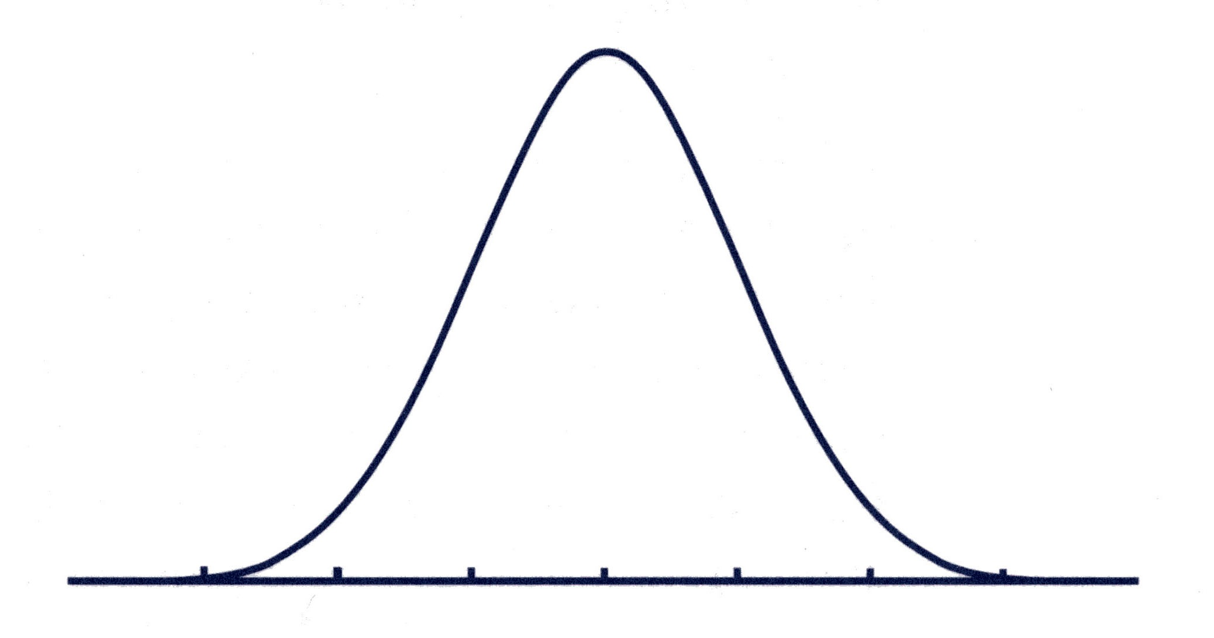
Fudge, Nudge & Budge
Within individual variation for target behavior base-lined using momentary instrumentation tools such as those based on mobile wellbeing productivity applications. This is the participant’s fudge-factor. Sometimes we hit our goals, mostly we don’t.
1
Current State
Trouble Zone
Typical Zone
Target Zone
A successful intervention means that that within individual behavior variation has significantly shifted to a new mean. The individual’s behavior has budged and this becomes the new norm. Again, our momentary instrumentation tool provides this information.
2
Future State
For the coach to effectively and efficiently tailor feedback, he needs to be able to detect when behavior is significantly straying into trouble zone. For example, the rule may be “if 3 consecutive days of missed goals”, then issue a nudge. The nudge could be customized content, invitation to 1-1 session etc. Actionable insight.
New Trouble
Zone
New Typical Zone
3
© StefanoPicozzi@gmail.com 2014

Slide 5
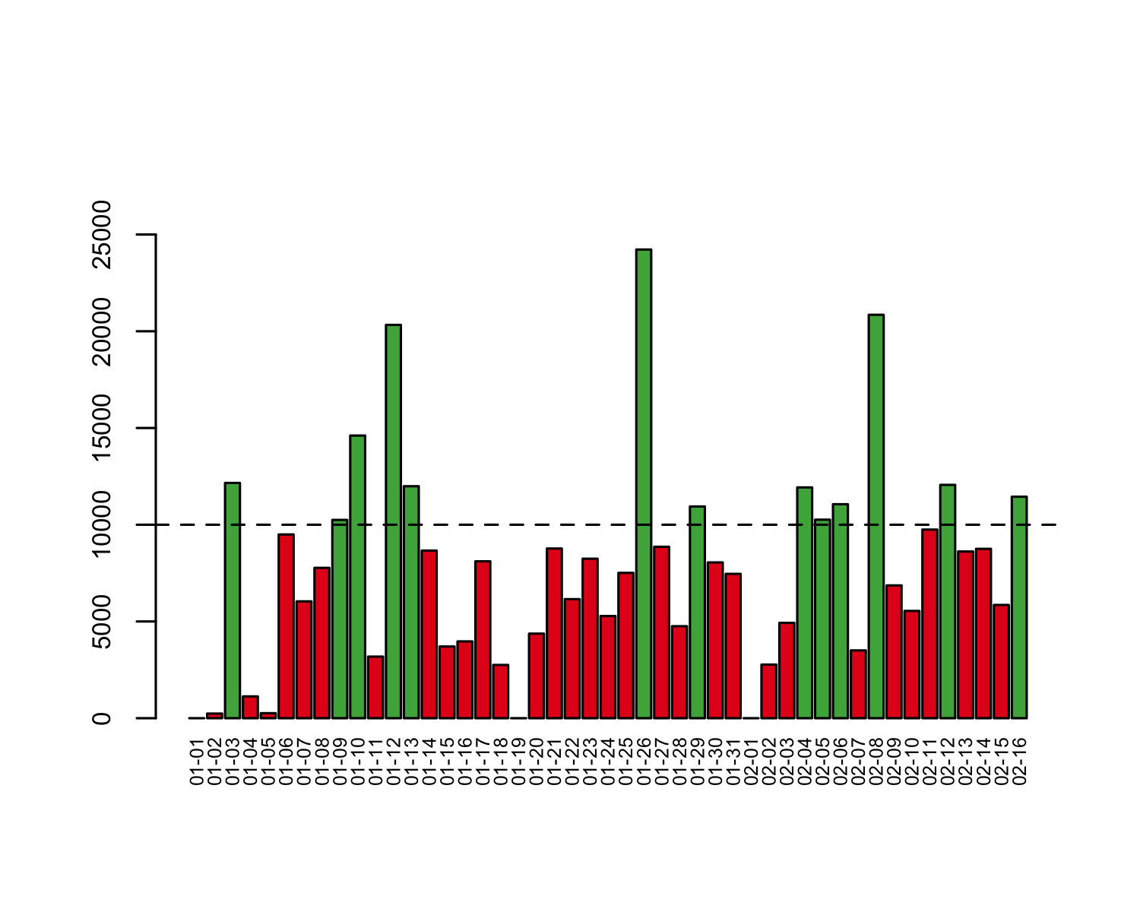

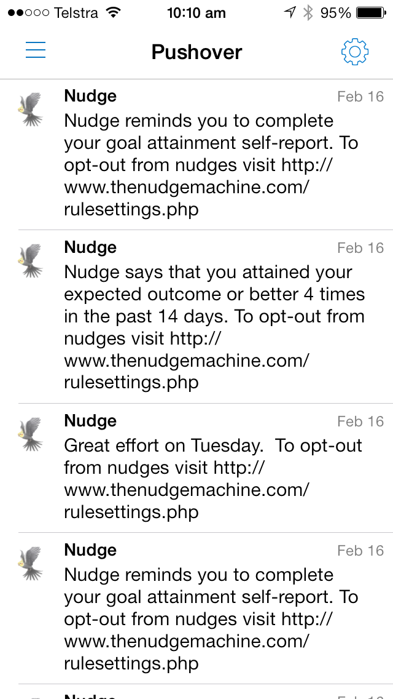

Behavioral Observations
Inputs can be sourced from wearable sensors, self-report, direct observation entry, 3rd party applications etc
Nu
d
The
ge
Machine
Coachee triggered to inspect nudges via push to mobile app, sms, email, web-site, 3rd party application etc
c
Behavioral Rules Based
Event Stream Engine
Coachee
Coachee
Coachee
Goal Setting
Opt-in Opt-out
Behavioral
Insights
Coachees and coaches collaborate on goal setting. Rules trigger nudges that include content of motivational goal-directed relevance to coachee
Behavioral Query Language
Goal Attainment Scale
Opt-in/out
Easily accessible to any 3rd party coaching application via a simple set of cloud based REST APIs
Ad Hoc Nudge
Self Report Reminder
Nudge Schedule
Snap Poll
Hypothesis Testing
Coach
© StefanoPicozzi@gmail.com 2014
Notes:
Motivation
Motivation to use system is that coachee is voluntarily engaged in some goal directed behavior
Ability
Ability to use system made easy as participants can access application anytime/anywhere via any ambulatory/convenient device * Behavioral observation data capture made easier over time as sensor technologies improve
Trigger
External - Coachees directed to the application via a signaling protocols, e.g. a trigger based on a push notification to a device
Internal – Coachees motivated to engage with tool as they have a change goal they wish to hit
Behavior
Nudge content has summary content that crates intrigue to then inspect content at more detail
Reward
Content of relevance to stakeholders in the process including coachees, coaches and research community and industry * Reinforcements can be on a variable schedule with support for range of signaling protocols * Coachees can get goal attainment summaries, charts, graphs, content pointers, personalized instruction, survey reminders * Goal performance succinctly summarized using consolidated, aggregates and sliding time windows to reduce noise * Coaches get insight into coachee performance, schedule * Coaches nudge coachees to help them make better goal-directed behavioral decisions
Investment
Coaches invest into the process as they can design and test behavioral hypotheses * Coaches can add content and polls at any time
Coachees iteratively define their goals and control what and when they receive feedback * Nudge – choice architecture – Paternalistic liberalism
Configurations reflects in changed system behavior * Expandable later to include coachee created content and social networking

Slide 6

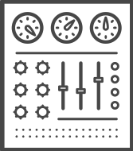

Feedback Loop: in-camera/in-situ
Coachee reports back self-report and/or sensor based data - EMA.
Outer Loop
Scheduled & Structured
“First Arena”
participate
Coach makes small correction to nudge rules.
respond
refine
Coachee
Coach
nudge
monitor
Inner Loop
Momentary & Contextual
“Second Arena”
NudgeMachine fires nudge rules based on EMA inputs - EMI.
NudgeMachine issues alert.
instruct
© StefanoPicozzi@gmail.com 2014
Notes:
People like to tell stories
People believe in stories
People use stories to rationalize their own lives

Slide 7
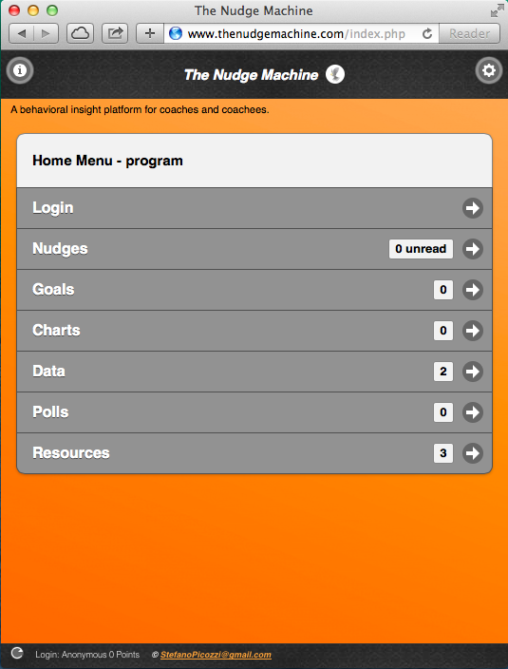
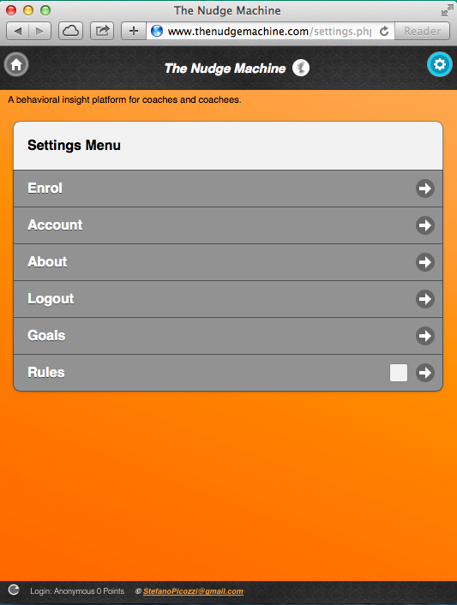
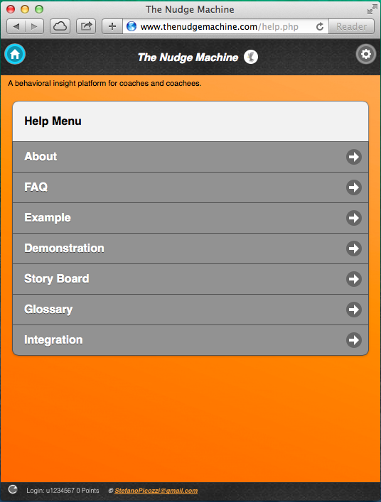
Coachee Functional Prototype
Home Menu
Settings Menu
Help Menu
© StefanoPicozzi@gmail.com 2014

Slide 8
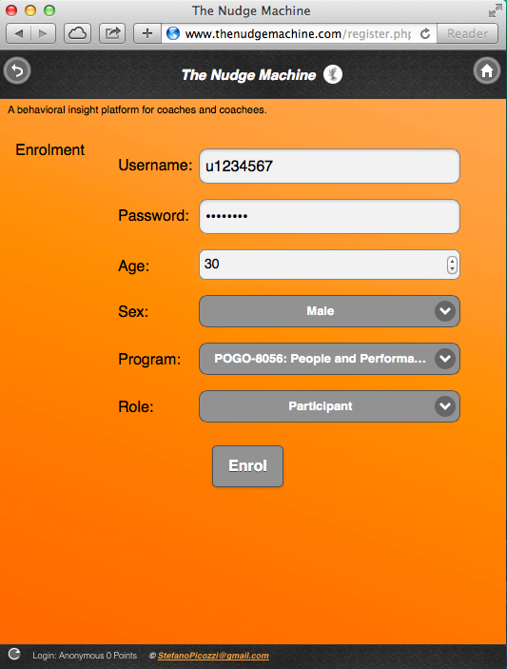
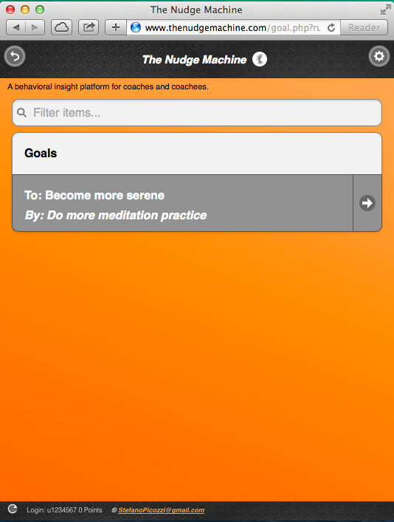
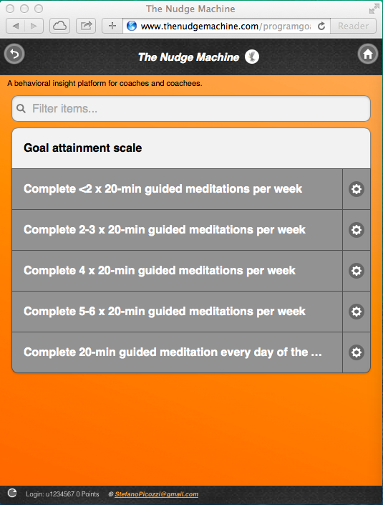
Coachee Functional Prototype
Enrolment
Goal Setting
Goal Scales
© StefanoPicozzi@gmail.com 2014

Slide 9
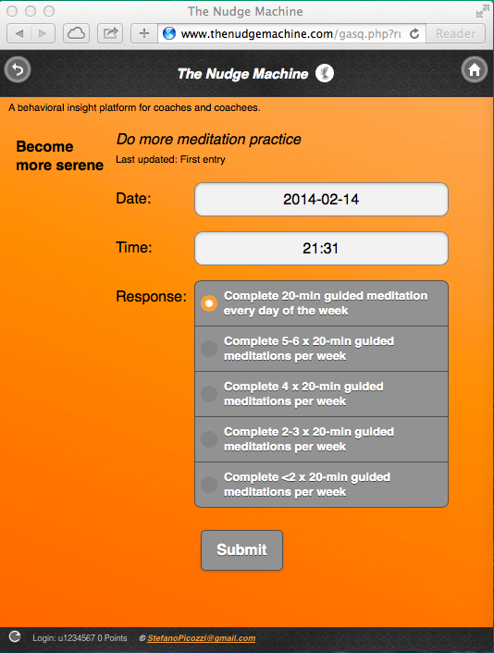
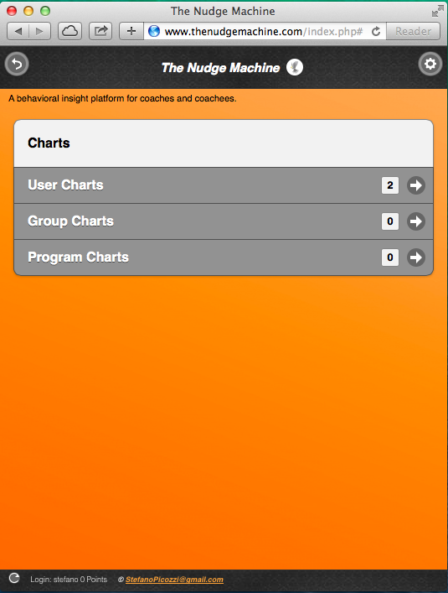
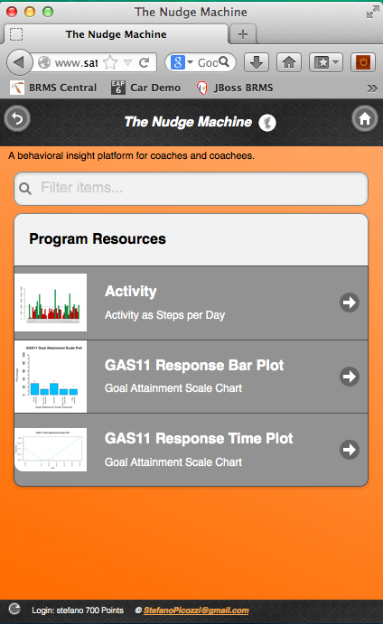
Coachee Functional Prototype
Goal Self Report
Charts
Chart Types
© StefanoPicozzi@gmail.com 2014

Slide 10
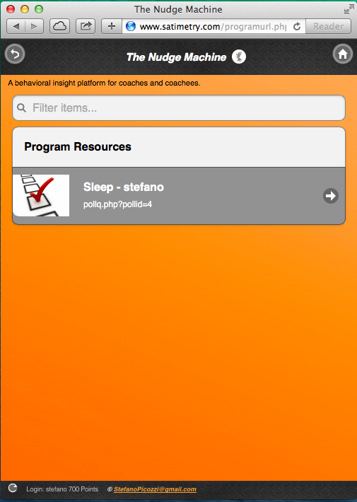
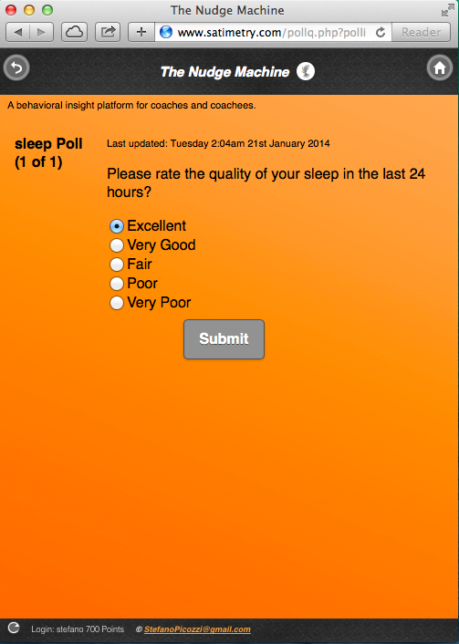
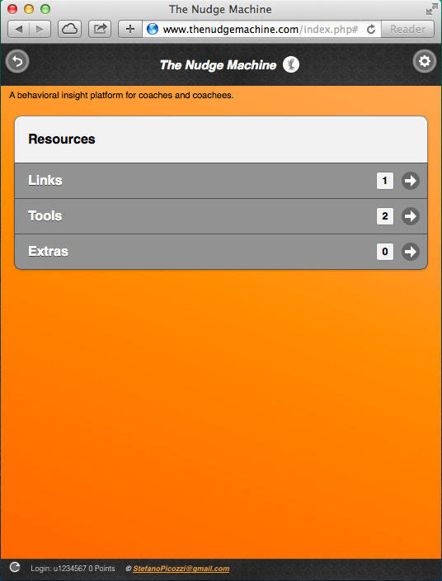
Coachee Functional Prototype
Polls
Poll Example
Resources
© StefanoPicozzi@gmail.com 2014

Slide 11
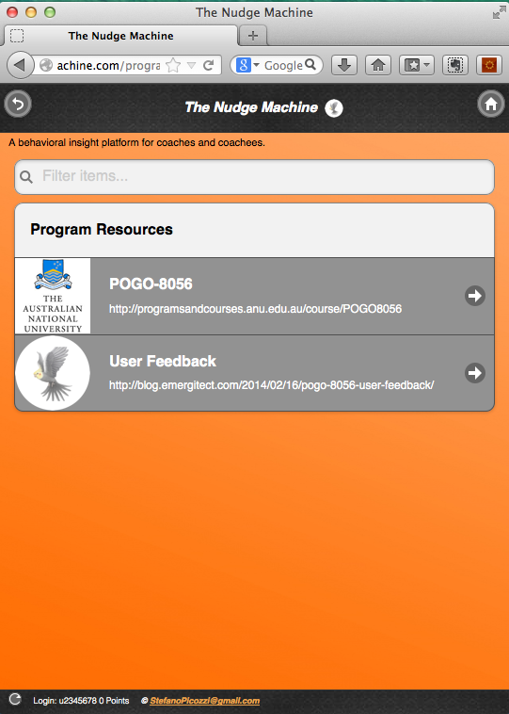
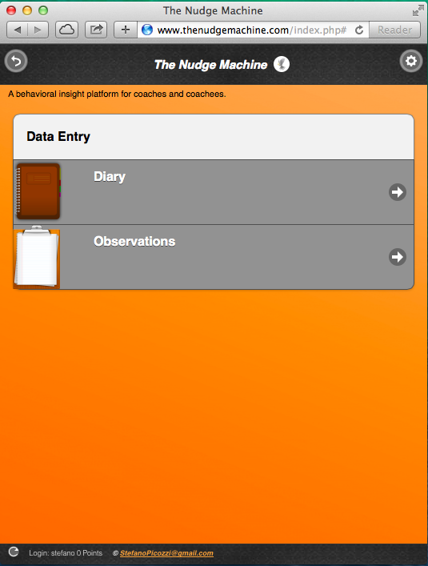
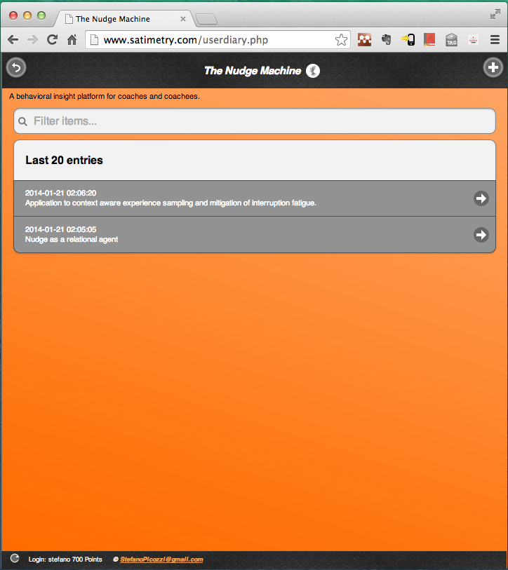
Coachee Functional Prototype
Links
Data Entry
Journals
© StefanoPicozzi@gmail.com 2014

Slide 12
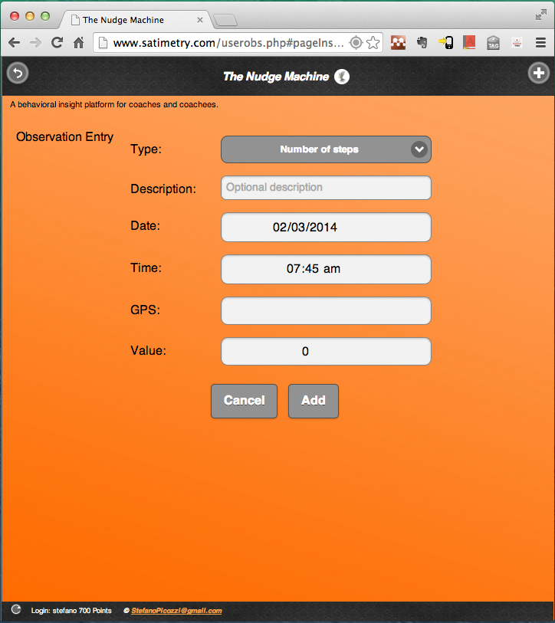
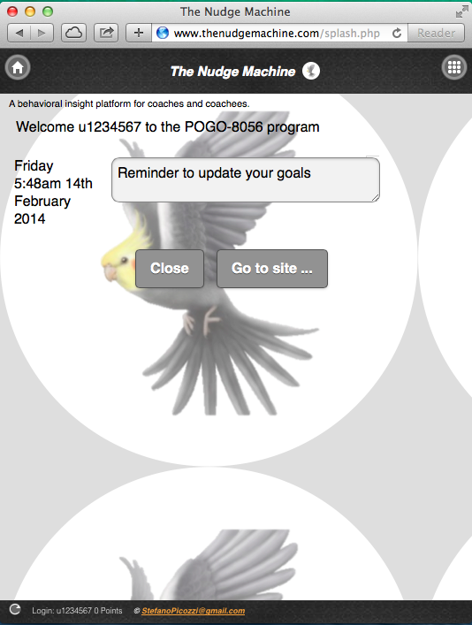
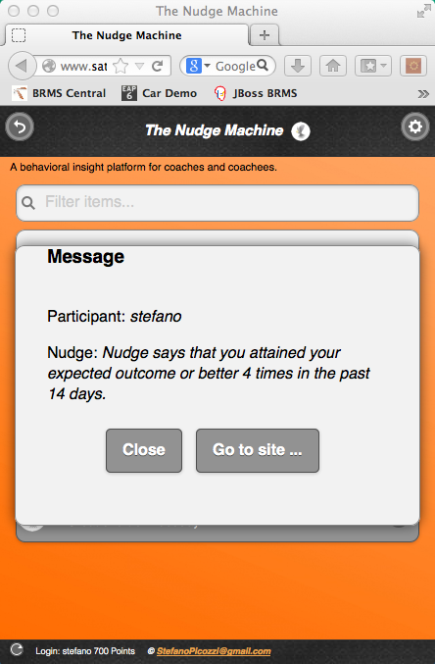
Coachee Functional Prototype
Observation Entry
Splash Screen
Nudges
© StefanoPicozzi@gmail.com 2014

Slide 13
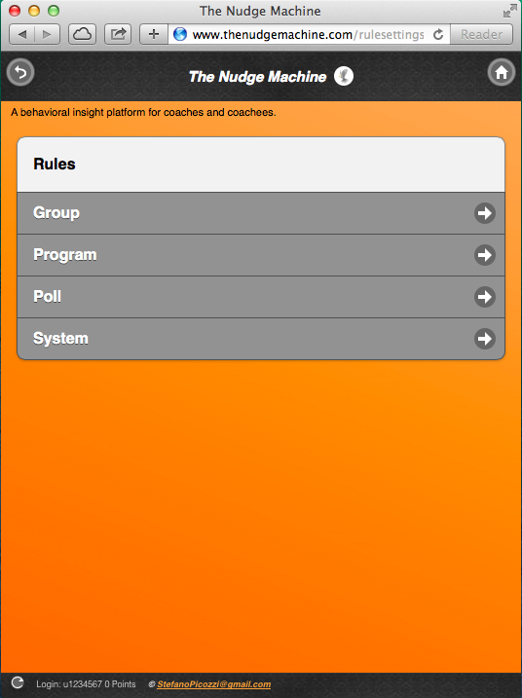
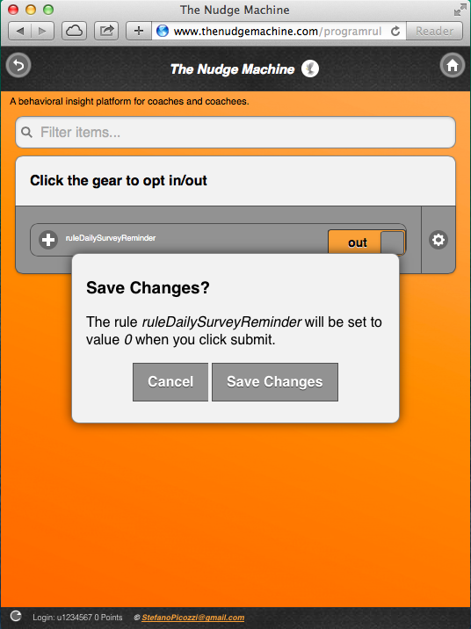
Coachee Functional Prototype
Rule Settings
Rule Opt in-out
Mobile Notifcations
© StefanoPicozzi@gmail.com 2014

Slide 14
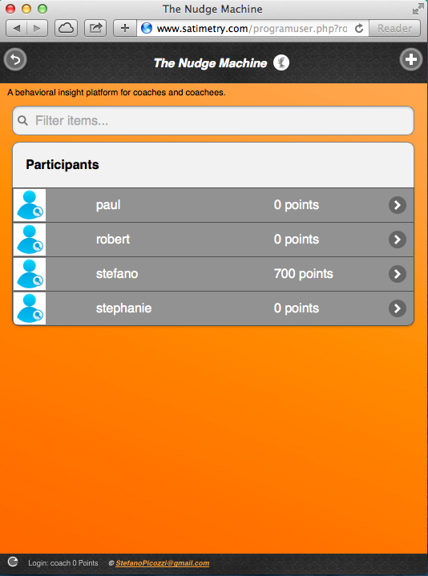
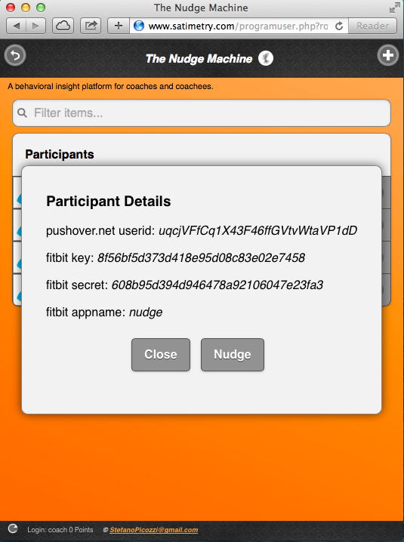
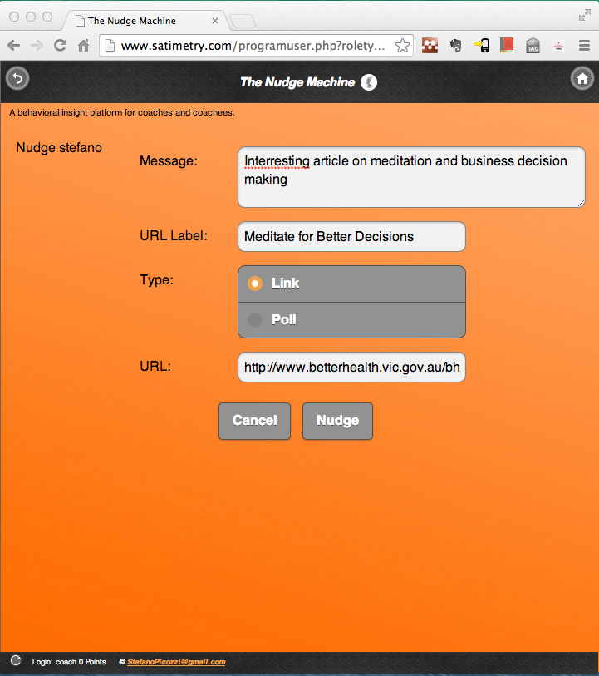
Coach Functional Prototype
Coachee List
Nudge Coachee
Ad hoc Nudge
c
© StefanoPicozzi@gmail.com 2014

Slide 15
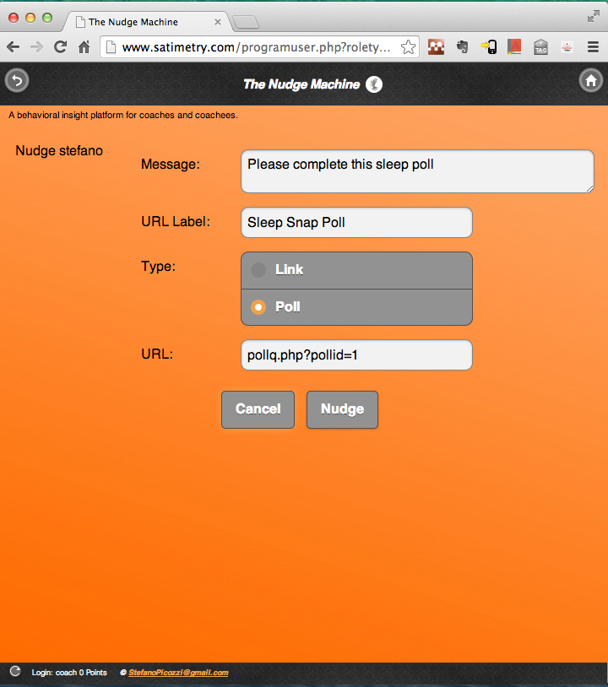
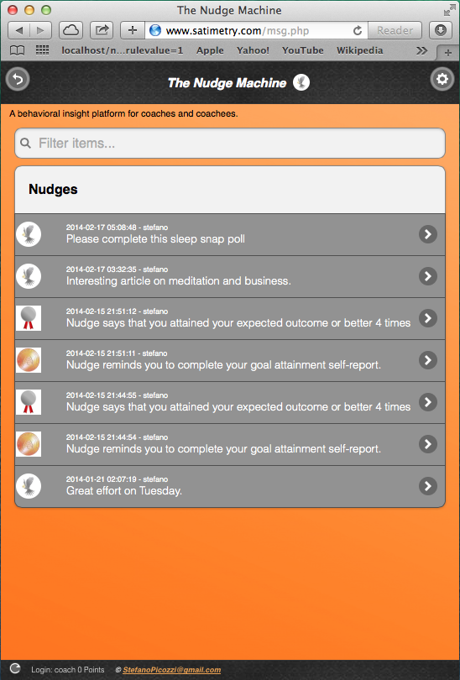
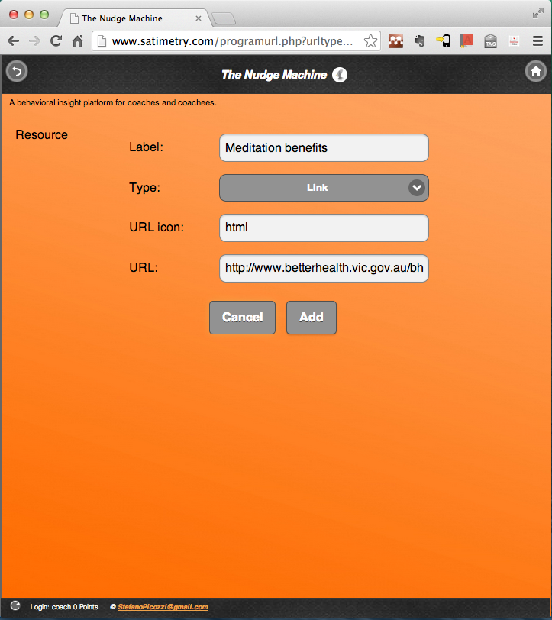
Coach Functional Prototype
Snap Poll
Nudges
Add Resources
© StefanoPicozzi@gmail.com 2014

Slide 16
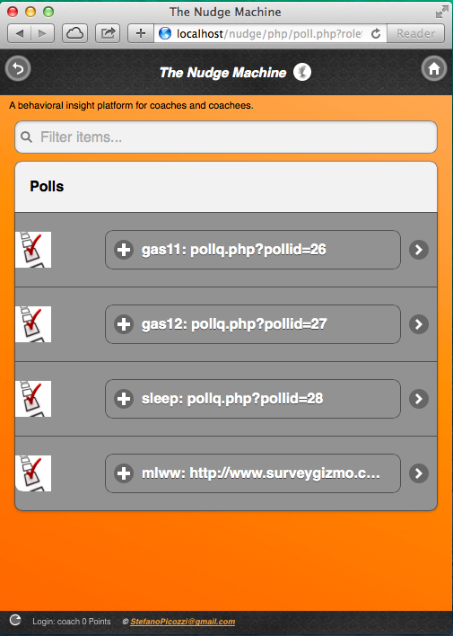
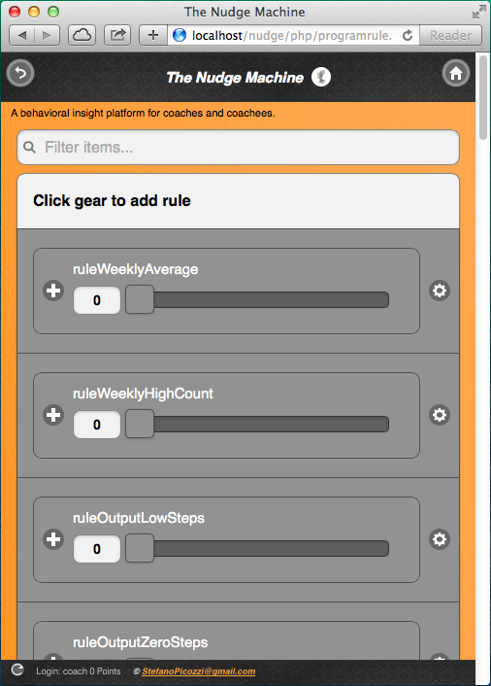
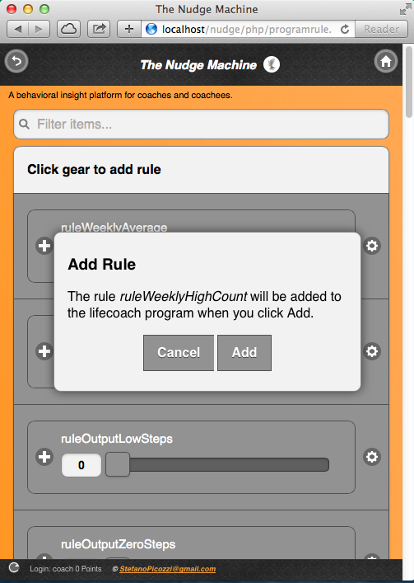
Coach Functional Prototype
Polls
Rule Assignment
Assign
© StefanoPicozzi@gmail.com 2014

Slide 17
Libertarian Paternalism
is paternalism in the sense that “it tries to influence choices in a way that will make choosers better off, as judged by themselves”
it is libertarian in the sense that it aims to ensure that “people should be free to opt out of specified arrangements if they choose to do so.”
the possibility to opt out is said to “preserve freedom of choice”.
© StefanoPicozzi@gmail.com 2014

Slide 18
A behavioral insight platform for coaches and coachees
Nu
d
ge
The
Machine
By Stefano Picozzi
March 2014
© StefanoPicozzi@gmail.com 2014

Slide 19
Feedback Loop – Social View
Assigned Buddy
Peer mentoring
Expert mentoring
c
c
Coachee
Coach
Social validation
Structured guidance
Cohort
© StefanoPicozzi@gmail.com 2014
Notes:
People like to tell stories
People believe in stories
People use stories to rationalize their own lives

Slide 20
Feedback Loop – Research View
ADAPT
D E S I G N
The ResearchSector informs design of behavior change interventions such as MBSR.
Researcher interprets published research and other external sources for guidance on intervention design and suggestions for research questions.
Over time a knowledge base will
build with multiple intervention
archetypes including a dashboard of historical performance
profiling benefit metrics for each.
Researcher mines intervention database to analyze results and infer intervention design refinements which are then published for peer review.
Researcher codifies MBSR intervention archetype as a TNM system rule set.
The
Nudge
Machine
Customized intervention instances are possible drawing from a composite of available archetypes
or modifying rules such as practice regime as appropriate.
Completed instance added to Intervention database. Specific hypotheses tested using intervention data. Historic data mined for clusters and patterns of interest.
ChangeArchitect and Participants interact through intervention and progress is 1) tracked using EMA captured data and 2) nudged using EMI.
Coach selects MBSR archetype and spawns an intervention instance codified as a TNM system rule set.
Coachees in collaboration with Coach enroll into the MBSR intervention instance with details such as interaction preferences and goals codified as TNM system rules.
Progress dashboards on individual and cohort basis tracking key performance indicators. Signaling mechanism prompts participant response. Participants respond via supported devices or through sensors as available.
Participant rules can be fine-grained such as opt-out of EMI prompts or tailored practice sets. Individualized electronic calendar entries generated and participant goals and commitments formalized.
EXECUTE
© StefanoPicozzi@gmail.com 2014
Notes:
People like to tell stories
People believe in stories
People use stories to rationalize their own lives

Slide 21
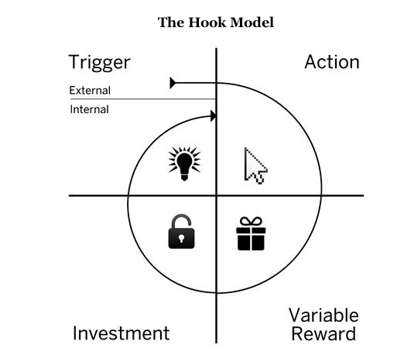
Hooked
A Coach in Your Pocket
© StefanoPicozzi@gmail.com 2014
Notes:
To
Assist in individual in supporting them through a behavior change goal
Support that can reach outside the classroom setting to remote or regional locations
A coach in your pocket
By
Platform that enables instrumentation and measurement framework
That can surface content that engages both coach and coachee to participate
Scale means discovering highly targeted insight, separating the signal from the noise
Scale means automation so that coaches can triage and manage who needs targeted support even in large populations
Delivered via Internet to any devices including mobile phone, tablets and desktop
So
Enables collaboration between the behavior change participants
Coachees and coaches are vested in the process as they can configure and control how they engage
All system events controlled by rules that can be opt-in/out
Feedback loop established based on cycle of observation, measurement, reinforcement and reward

Slide 22
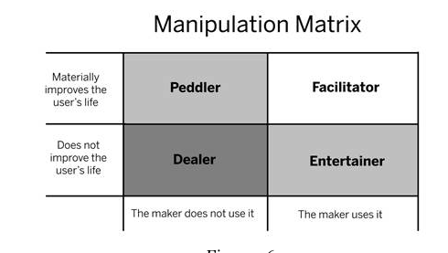
Hooked
A Coach in Your Pocket
© StefanoPicozzi@gmail.com 2014
Notes:
To
Assist in individual in supporting them through a behavior change goal
Support that can reach outside the classroom setting to remote or regional locations
A coach in your pocket
By
Platform that enables instrumentation and measurement framework
That can surface content that engages both coach and coachee to participate
Scale means discovering highly targeted insight, separating the signal from the noise
Scale means automation so that coaches can triage and manage who needs targeted support even in large populations
Delivered via Internet to any devices including mobile phone, tablets and desktop
So
Enables collaboration between the behavior change participants
Coachees and coaches are vested in the process as they can configure and control how they engage
All system events controlled by rules that can be opt-in/out
Feedback loop established based on cycle of observation, measurement, reinforcement and reward

Slide 23
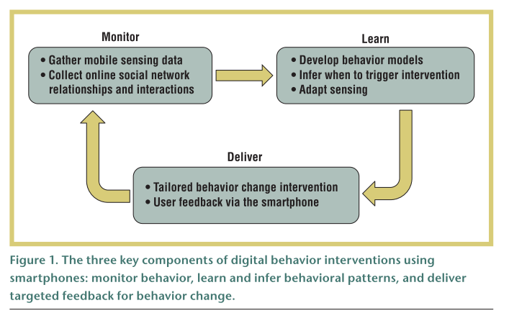
Hooked
A Coach in Your Pocket
© StefanoPicozzi@gmail.com 2014
Notes:
To
Assist in individual in supporting them through a behavior change goal
Support that can reach outside the classroom setting to remote or regional locations
A coach in your pocket
By
Platform that enables instrumentation and measurement framework
That can surface content that engages both coach and coachee to participate
Scale means discovering highly targeted insight, separating the signal from the noise
Scale means automation so that coaches can triage and manage who needs targeted support even in large populations
Delivered via Internet to any devices including mobile phone, tablets and desktop
So
Enables collaboration between the behavior change participants
Coachees and coaches are vested in the process as they can configure and control how they engage
All system events controlled by rules that can be opt-in/out
Feedback loop established based on cycle of observation, measurement, reinforcement and reward

